Slide 1
Service Creation Tools -
Hide or Publish?
Joakim Pettersson

Slide 2

Ideas
Goal:
  Simple, extendable services for common needs
  Use familiar words or symbolism with well-established interpretation
State-of-the-art:
  Heavily technology-dependent, both in their application programming interfaces (APIs) and documentation
Approach:
  Real-world: directly understood also by non-technicians
  Compact: easy coding, testing and maintenance also for non-experts
  Interactive: easy to consolidate or correct initial interpretation
  Transparent: interconnected platforms & programming languages

Slide 3
Features (italic = under construction)
Core extendable services
  Phone & Team (Parlay)
  PDA & PC (IP)
  Agent (FIPA, Web start)
Bonus services when using Python
  Author, Publisher & Subscriber (telnet, http, RMI)
  Verified, Maintained, Shared & Saved (introspection)
Basic functionality
Extendable services
Interactive environment
IP
OSS, GIS, Web, GUI
Socket, RMI, VPN
AAA
QoS
IITIDE
Verified
Maintained
Shared
Saved
Vertical-market applications
IITLIB
SIP
IITAPI
PC
PDA
Phone
Team
Author
Publisher
Subscriber
Python
Java
C++
C#
IMS
Parlay X
Parlay
Connects to WCDMA system
NRGSDK
Parlay/OSA+Ericsson functions
IITSDK
Call
SMS
MMS
Locate
Equivalent design time and code size
Python: Hours, ~1 page
Telephony applications
Java: Days, ~3 pages
Java: Weeks, ~10 pages
CORBA: Months, ~30 pages

Slide 4
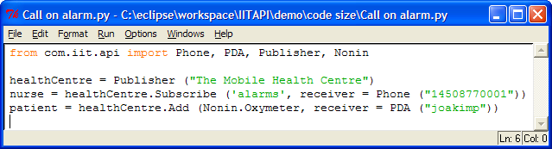







Example: Alarm → Phone call
Sensor
Patient
Publisher
Author
samples, alarm
Actuator
treatment
Nurse
“Care instruction”
Subscriber

Slide 5
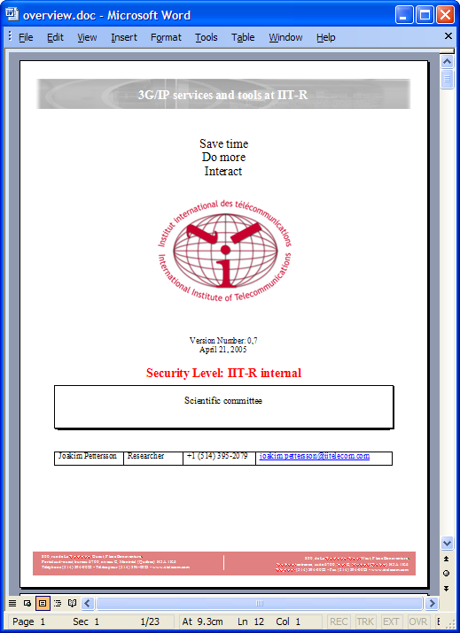
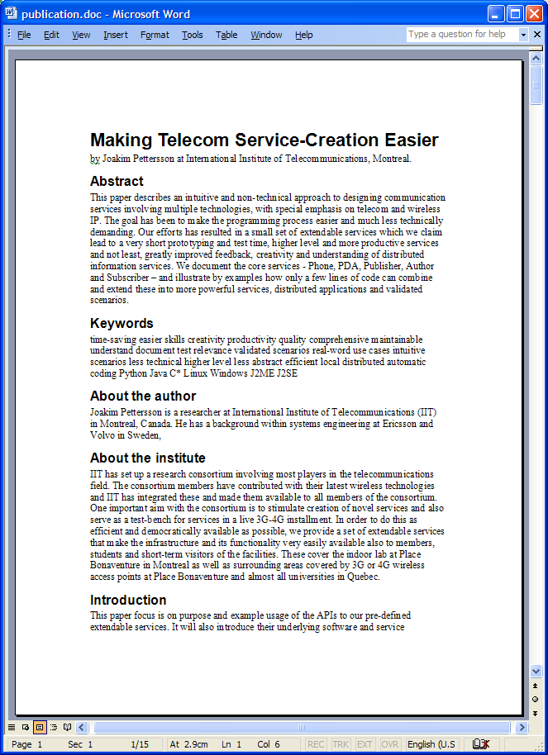
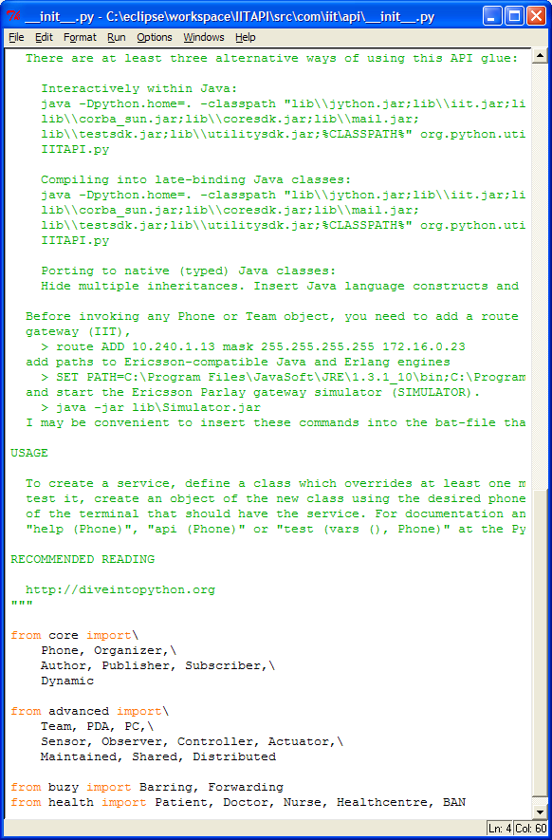
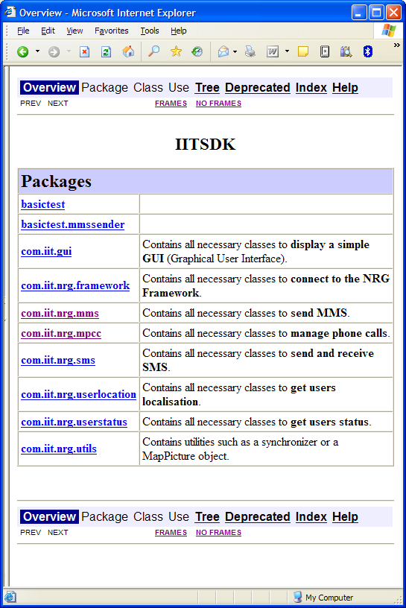
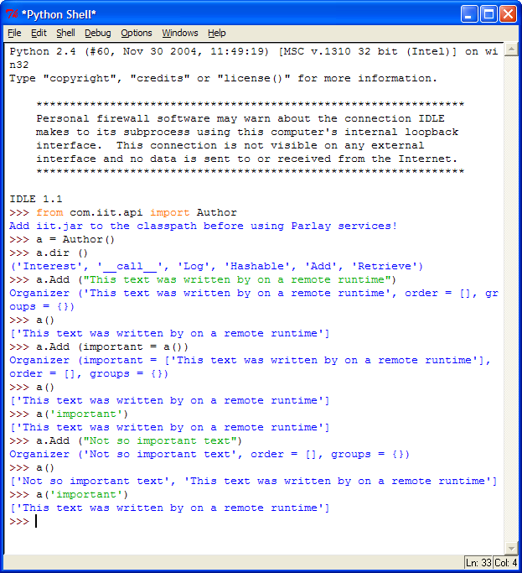
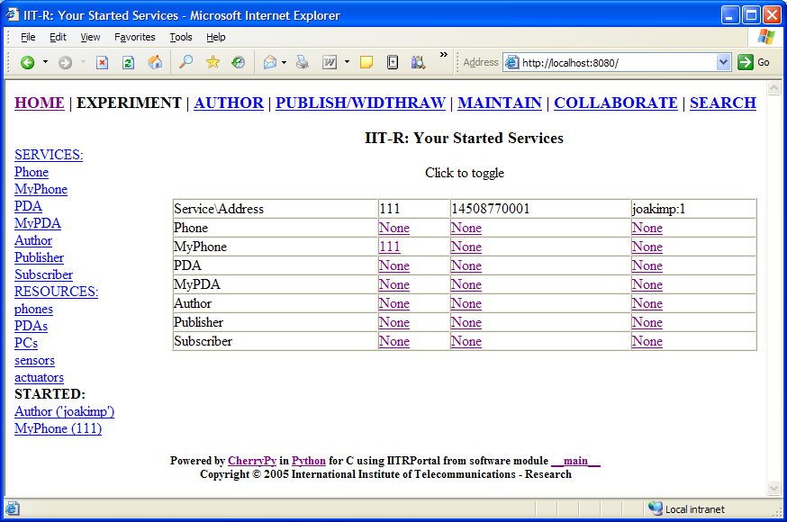
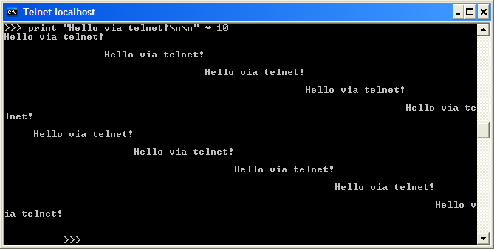
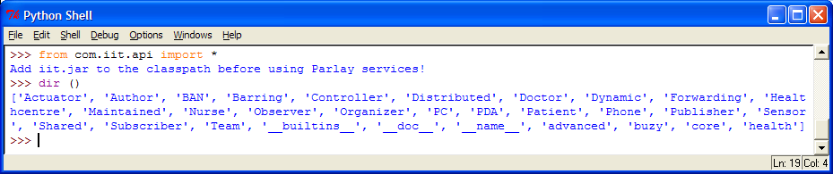
Deliverables
Report Purpose Description | Publication Ideas Examples | IITAPI library src & doc lib & doc | IITSDK library src & doc lib & doc
Examples Telephony Messaging Localization Observing Controlling Portable GUI | Python client | IIT-R portal | Telnet client

Slide 6
The IIT-R Service Portal
Toolbar for workflow support
Sidebar for quick access
Main area for inspection and configuration
Telnet session for direct interaction

Slide 7
Decisions needed
Suggestions for the IIT-R Service Portal?
Where, what and how to publish?
  Report: Public or restricted on IIT-R portal?
  Publication: IEEE Software, telecom journal or restricted on IIT-R portal?
  IITAPI & IITSDK: Source on SourceForge.org or binary on IIT-R portal?
  Examples: Public or restricted on IIT-R portal?
  Python client: Public or restricted on IIT-R portal?
  Web client: Public or restricted on IIT-R portal?
  Telnet client: Public or restricted on IIT-R portal?
Ownership (.py, .jar & .doc) after my assignment?

